Slide 1
Diversified Funding its Importance, Types & Benefits
Nancy A. Maier
Chief Development Officer

Slide 2
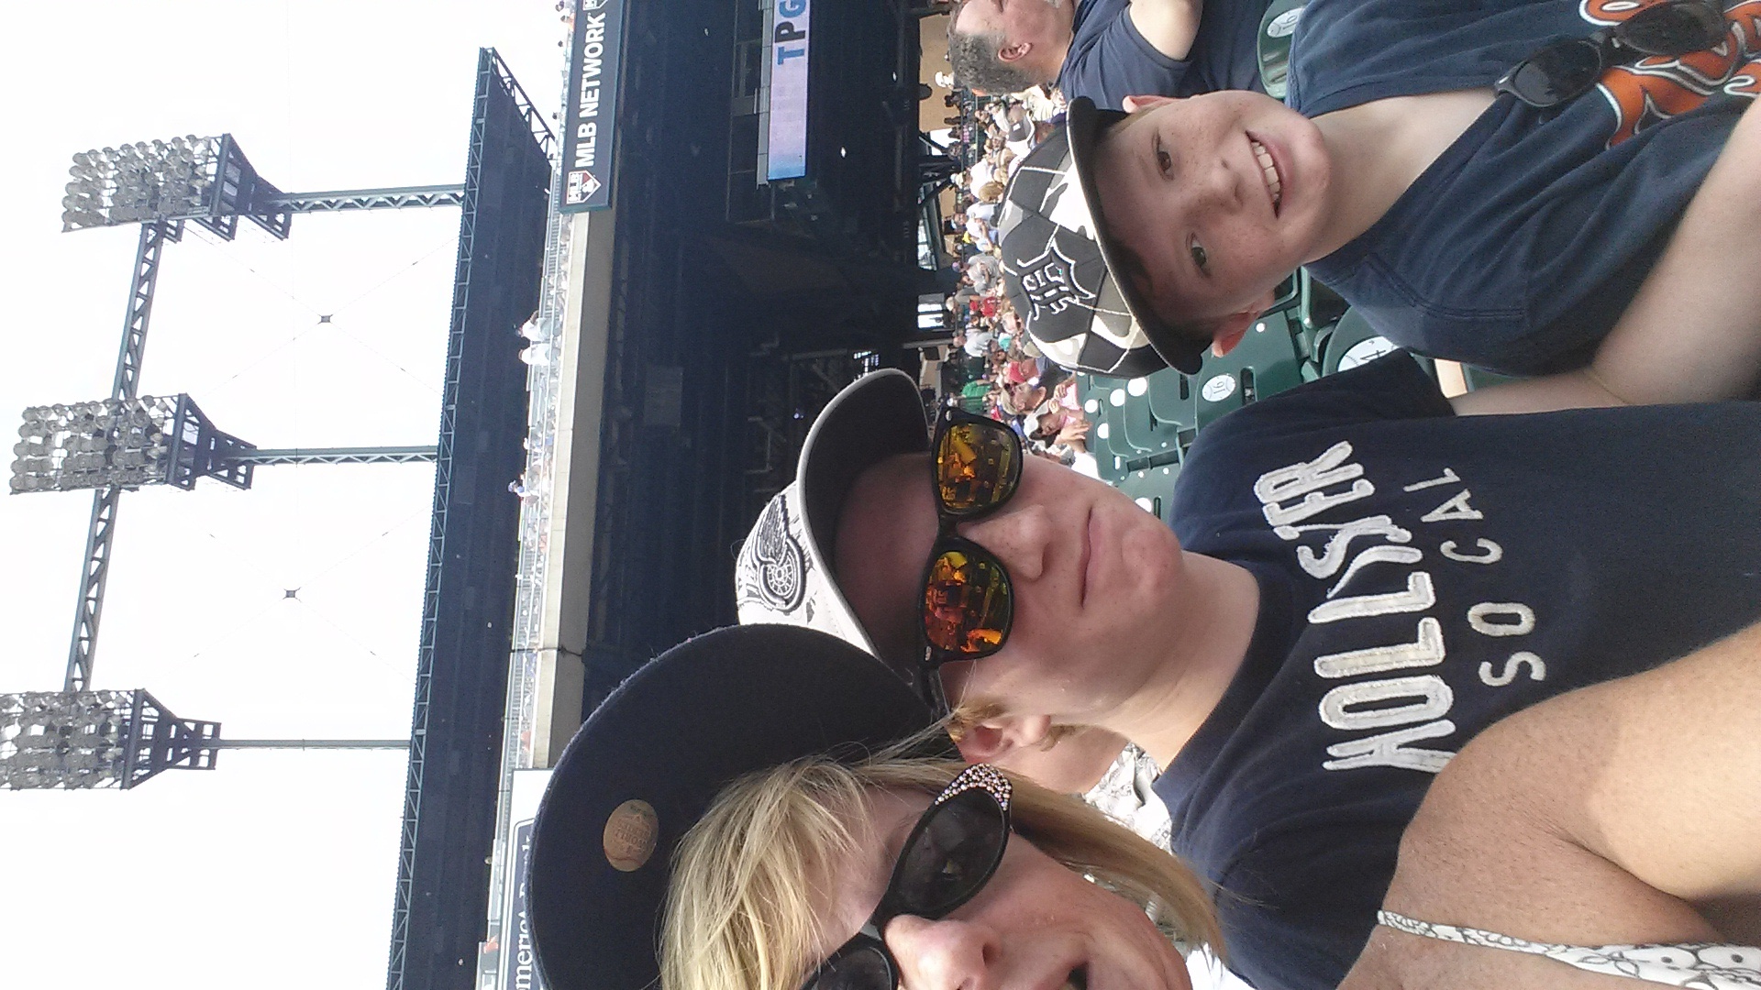
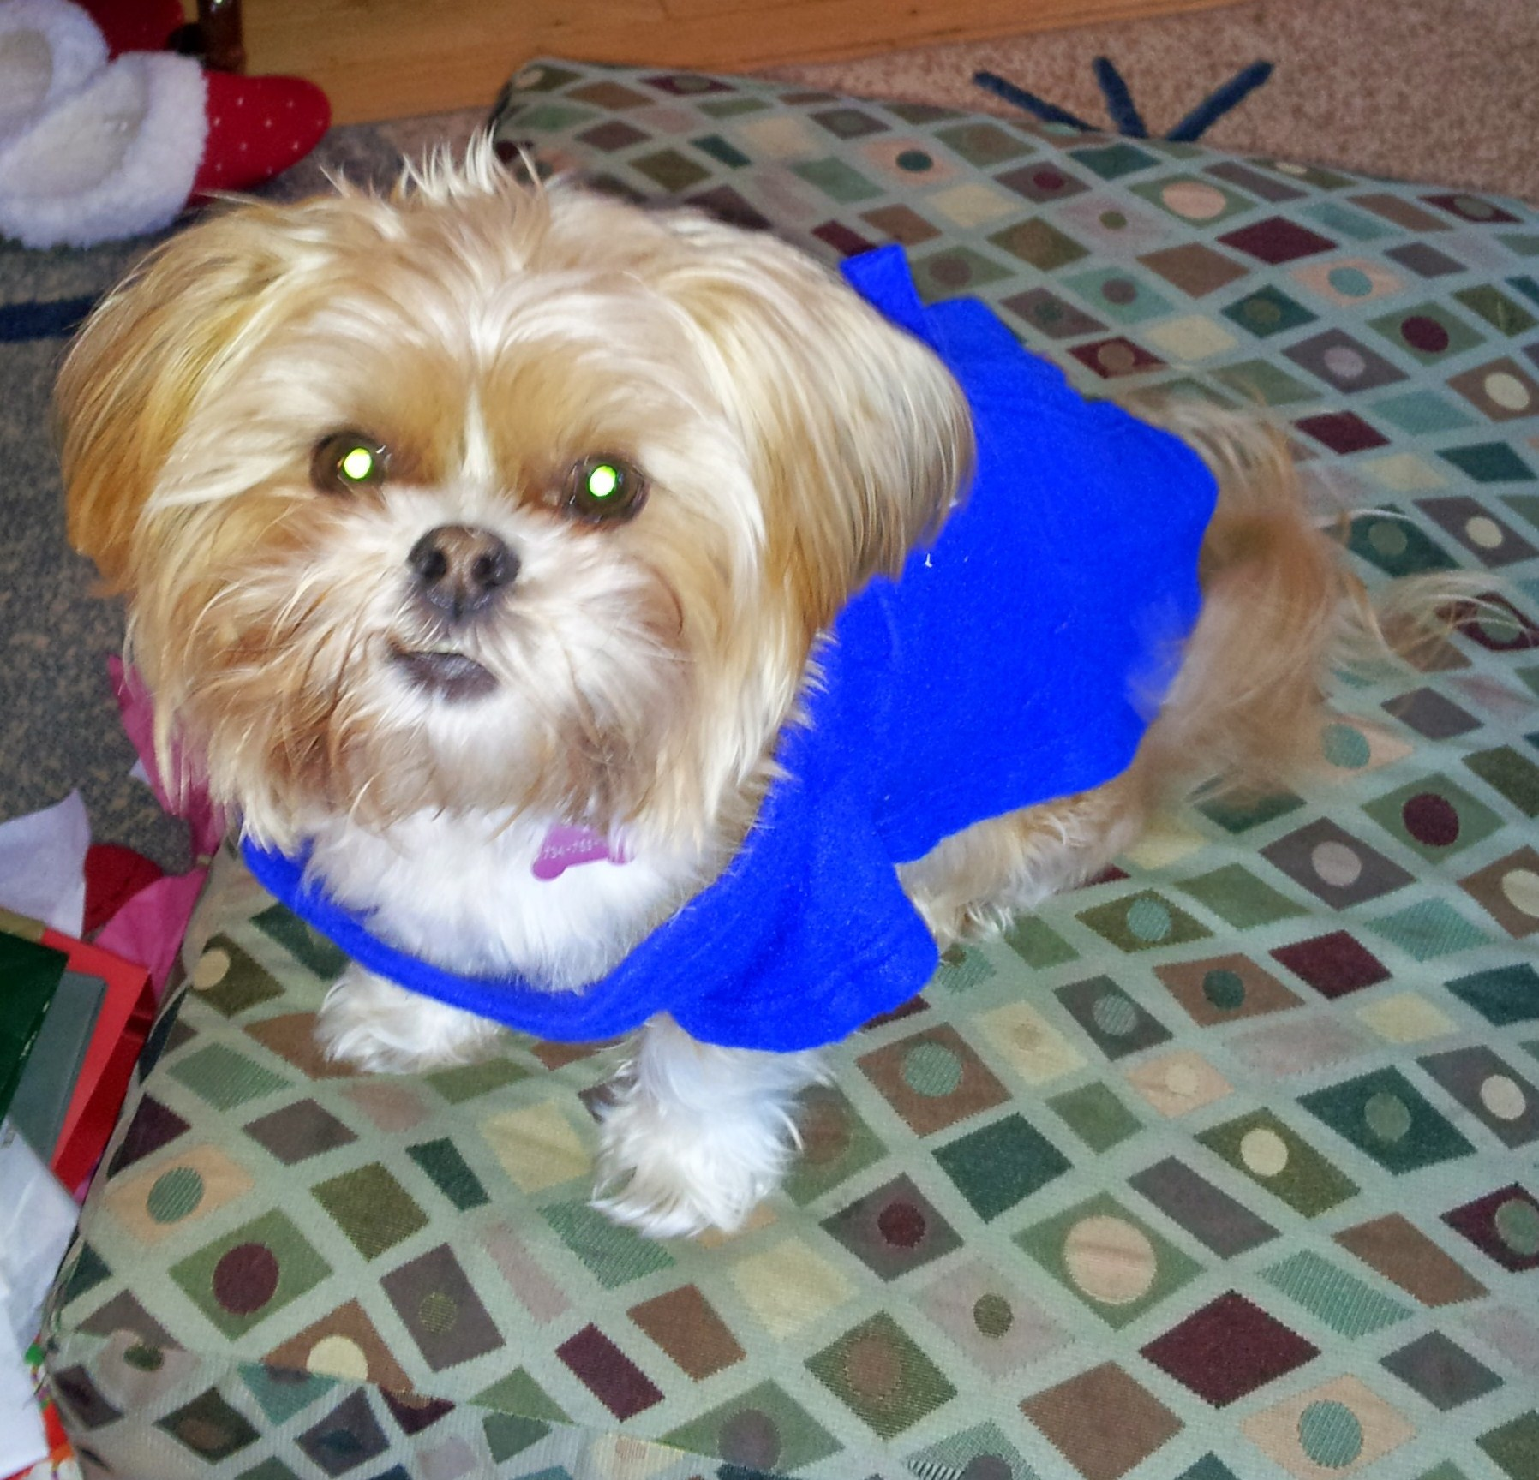
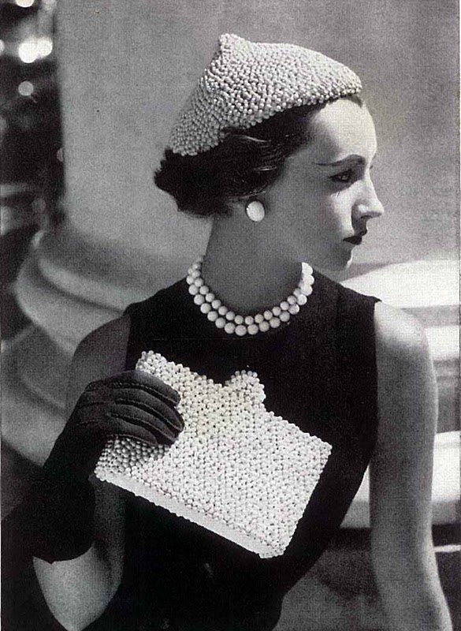
About me…
I have two kids and a dog
Avid reader and sports enthusiast
I like vintage
Investigative Discovery Channel = my guilty pleasure
How did I end up here?
People are my passion
I really enjoy the dynamics of organizational change
Been with the MDA Foundation about 18 months

Slide 3
Michigan Dental Association Foundation
Founded in 1998
Volunteer led for 16 years
I was hired in year 17
Mission to provide scholarships to future dental professionals and grants to organizations serving Michigan’s most vulnerable populations
Total assets of $1.8 million
Donors to the Foundation annually: 1,750

Slide 4
Michigan Dental Association Foundation
Current fundraising programs
Car Raffle
Golf Outing
Dues Invoice
Inner Circle Annual Campaign
Miscellaneous fundraising
Ornaments
Kroger program
Sports teams raffle income
Mission of Mercy (not an annual program)
Current giving programs
Scholarships
Dental Students
Dental Hygiene Students
Dental Assisting Students
Grants
Organizations/Clinics serving uninsured, under-insured, homeless
Programs offering educational initiatives to improve dental health

Slide 5
So, what’s in store?
This should be fun
Let’s be interactive
Boring is not an option
We will all walk away with at least one “ah hah” or “hmmmmm”
Let’s Do This…

Slide 6
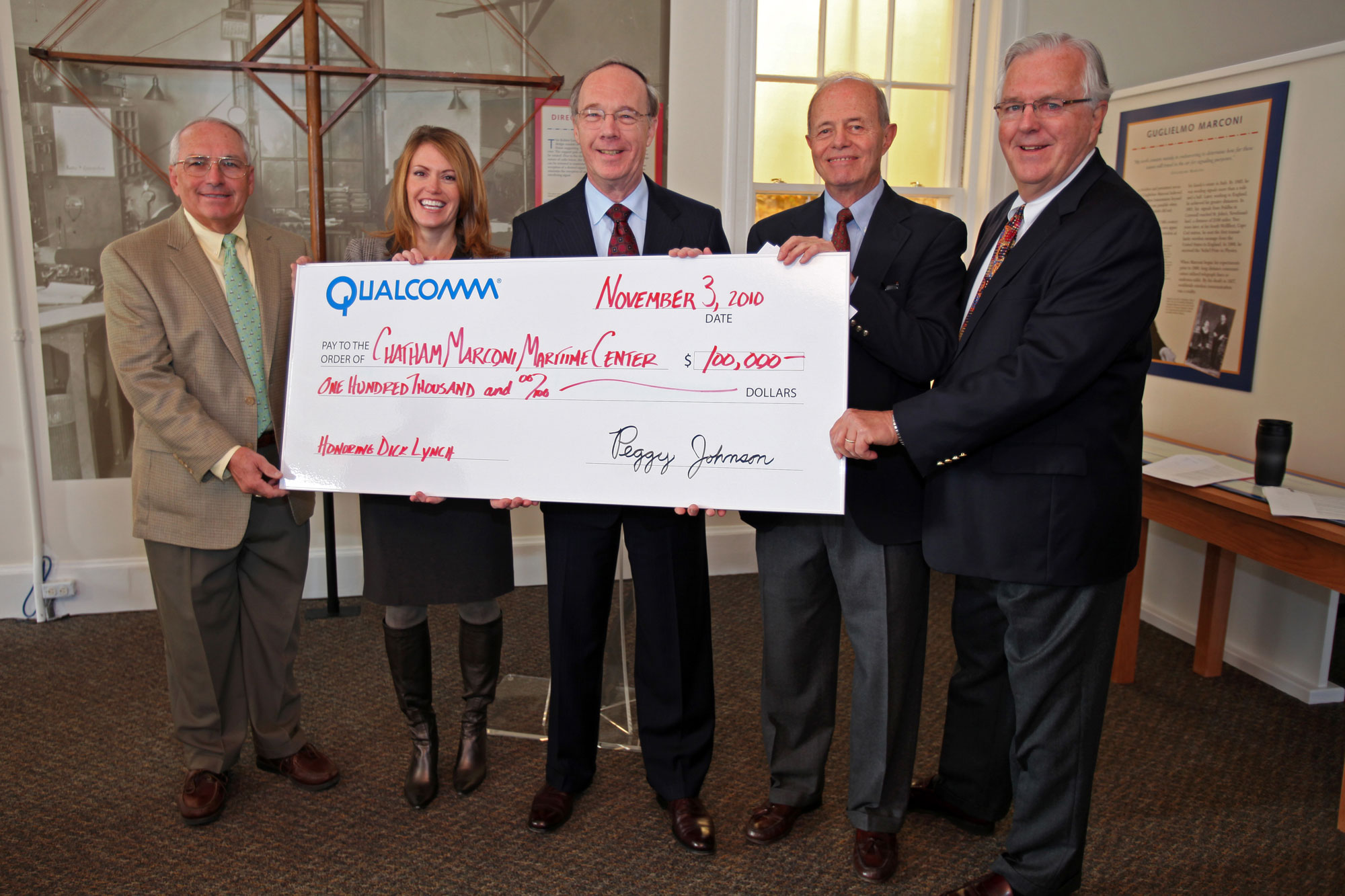
What is diversified funding?
Definition
A risk-reduction strategy involving adding several types of revenue generating fundraising programs, products, services, donors and markets to your organization.
Examples
Annual Gifts, Major Gifts, Planned Gifts, Corporate, Grants, Events

Slide 7
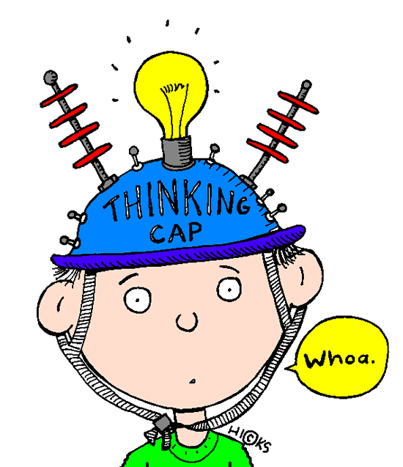
Diversified funding – why?
Why is it important for our organizations to diversify our funding streams?
Here’s our first interactive learning exercise!
When I point to you/call your name, shout or enthusiastically share why you think diversified funding is important
Here we Go!

Slide 8
How did we do?
Less risk for the organization
Creating Partners vs. Transactions
Possible increase in donors/prospect pipeline
Variety of ways for prospects to enter the organization
May create a sustainable organization
Should create donor centered fundraising
Provides a prospect management path
Should ensure consistent growth vs. stagnation
Provides additional avenues for donor retention
More engaged/active board members, volunteers/members/alumni(ae)
Shifting from one size fits all to a Culture of Philanthropy

Slide 9
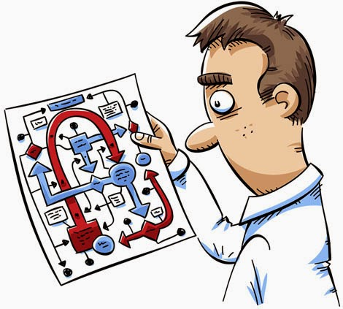
What does all of this mean?
Now we know what diversification is
We know why it’s important
We even understand what having diversified revenue streams can do for our organization
So….. if an organization appears to have a mix of revenue (diversified funding) is it successful?

Slide 10
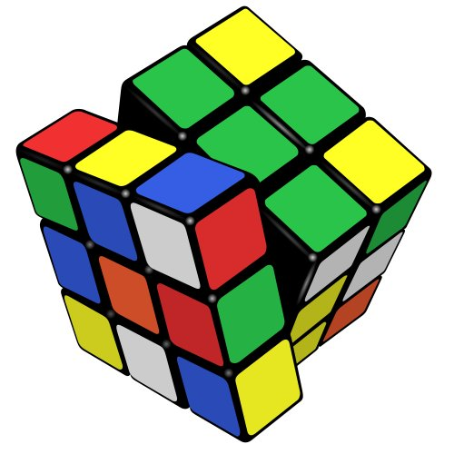
Let’s figure it out!
Examples of Diversified funding
Annual Giving
Major Gifts
Planned Gifts
Corporate Support
Grants (Corporate, Foundation, Government)
Events
Another Interactive learning session!
Six groups of 3 – 4 people
Notes:
15 minutes – Choose one or two methods you use to raise annual giving dollars. Then, determine the positive aspects and the challenges when using this method.
Here’s a quick example not listed: Sponsorships. We obtain sponsors for our Mission of Mercy Program. The positive/pro to using this method is it opens up other areas within a corporation for additional funding. Sponsorships usually take less time to obtain from an organization than a grant and they can be larger. The challenges are not predictable, can have heavy demands and depending on the project, may not be renewable.
Then determine one or two things that we can do as leaders to capitalize on the positive and minimalize the challenges.
Record your discussion points on the flip charts/note pads and choose one person to report to the group. I will come around to each group to help/answer any questions you have.

Slide 11
Summary of reports… What did we ?
If you have more than 40% of your revenue in one category, it’s RISKY!
Will diversified funding streams create success?
Well, that depends………
As leaders, we must keep the following in mind:
Mission – Relationships
Focus – Back-end
Resources
Staffing

Slide 12
Michigan Dental Association Foundation
Current fundraising programs
Car Raffle
Golf Outing
Dues Invoice
Inner Circle Annual Campaign
Miscellaneous fundraising
Ornaments
Kroger program
Sports teams raffle income
Mission of Mercy (not an annual program)
Current giving programs
Scholarships
Dental Students
Dental Hygiene Students
Dental Assisting Students
Grants
Organizations/Clinics serving uninsured, under-insured, homeless
Programs offering educational initiatives to improve dental health
Notes:
Remember this? Let’s take a better look at the types of revenue…..it’s event heavy, and that dues invoice…..

Slide 13
By the numbers -
Funds | 2012 | 2013 | 2014 | 2015* | 2016* | 2017* | 2018* | 2019*
Dues Revenue | $79,560 | $76,837 | $91,711 | $91,800 | $91,855 | $91,920 | $91,975 | $92,025
Car Raffle | 39,875 | 39,675 | 41,800 | 45,000 | 45,000 | 45,000 | 45,000 | 45,000
Golf Outing | 23,798 | 26,175 | 27,670 | 35,000 | 40,000 | 45,000 | 45,500 | 46,000
Inner Circle | 12,750 | 12,045 | 25,305 | 35,000 | 45,000 | 60,000 | 75,000 | 90,000
Major Gifts |  |  |  | 20,000 | 30,000 | 40,000 | 50,000 | 75,000
TOTAL | 155,983 | 154,732 | 186,486 | 226,800 | 251,855 | 286,920 | 312,475 | 353,025
+/- annual increase or decrease | -10% | -1% | +21% | +22% | +11% | +14% | +9% | 13%
Revenue
Funds | 2012 | 2013 | 2014 | 2015* | 2016* | 2017* | 2018* | 2019*
Grants | 15,000 | 15,000 | 15,000 | 40,000 | 60,000 | 75,000 | 80,000 | 90,000
Scholarships | 11,000 | 12,500 | 12,500 | 20,000 | 30,000 | 35,000 | 40,000 | 45,000
Education |  | 10,000 | 7,000 | 15,000 | 15,000 | 15,000 | 20,000 | 20,000
Matching Grants |  |  | 9,080 | 12,000 | 15,000 | 16,000 | 16,000 | 18,000
TOTAL | 26,000 | 37,500 | 43,580 | 92,000 | 120,000 | 141,000 | 156,000 | 173,000
% of dollars gifted | Based on prev. year assets |  | 2% giving $1.9 M | 4% giving $1.8 M | 6% giving | 7% giving | 8% giving | 9% giving
Expense

Slide 14
Foundation moving to next level
New board members
Accountability
Assessments
Mission/Donor/Relationship focused
Collaboration/Partnerships vs. isolated operations
Ongoing proactive assessment of all programs/services and operations
Notes:
50% of our Foundation board is new this year.
100% of our board members will have measurable accountabilities and will be assessed (self-assessment and assessment by governance committee)
Focus of the board will be on mission and donor intent
The theme for 2015/2016 is collaboration and partnerships.
Foundation Board members will explore and recommend ways in which to partner with others in our communities to maximize the Foundation’s awareness and impact.
We are ready to move from a working board to a strategy/policy setting board.
And, in order to measure our progress, we will participate in our audit and conduct proactive assessments of all our programs/services and yes, our operations.

Slide 15
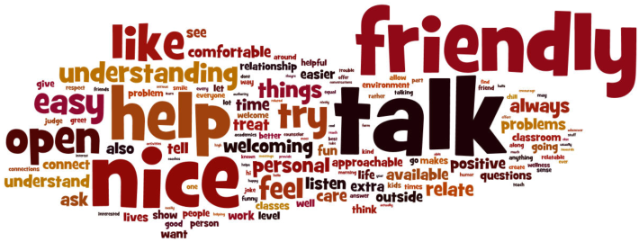
Mission, Donor, Relationship Focused
The steps we are taking
Relationships
Getting to know our donors/members/potential donors
Communicating/meeting regularly with donors/members/community leaders
Printed Annual Report mailed to all members/donors
Recognition of our donors and award recipients at Annual Session
Consistent outreach and LISTENING
Performance Audit/Feasibility Study
Audit/study to provide information on our operations, strengths and areas needing improvement
Springboard to a thorough strategic planning process
Will begin later this year and be finished Q1 2016
Annual Development & Gifting Plan

Slide 16
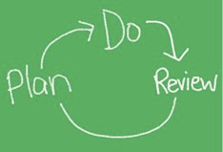
Take time to review
Mission
Funding stream
Is it diversified enough?
Resources
Relationships!
Important to your organization’s future
Notes:
It’s no secret, 2014 ushered in big changes for the Foundation.
New staff person, new Interim President, our first open call for board members and revisions to our bylaws.
The learning curve for me proved to be like that movie: Fast and Furious!
When the dust cleared, here’s how 2014 ended…

Slide 17
Final Interactive Learning Exercise!
Using your memory/development skills…
Would I rather read a mystery or love story?
Is Breakfast at Tiffany or Indiana Jones my favorite movie?
Does my freezer have plenty of beef?
Is my refridgerator full?
Am I working to create cat-friendly parks?

Slide 18
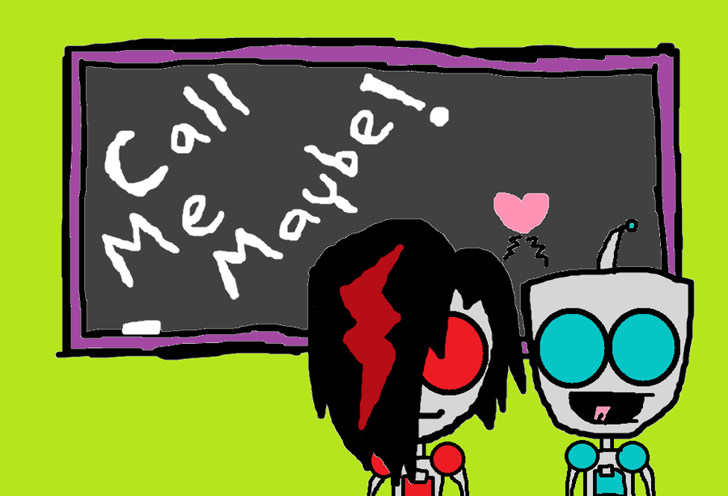
My contact information….
Email Address
nmaier@michigandental.org or foundation@michigandental.org
Telephone
734-765-1197 (cell)
800-589-2632 ext. 423
Website
smilemichigan.com/foundation

Slide 19
Questions
THANK YOU!

